Slide 1
Unit-I Chapter 02
System Design

Slide 2
Contents
OOP Fundamentals
Classes and Objects
Enums
Interfaces
Encapsulation
Abstraction
Inheritance
Polymorphism)
Class Relationships ( Association, Aggregation, Composition, Dependency).

Slide 3
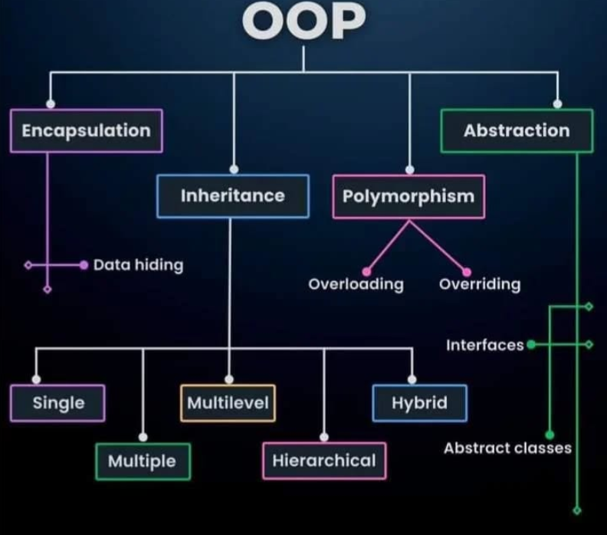

Slide 4
OOP - INTRODUCTION
Object-Oriented Programming (OOP) is a programming paradigm that models software systems using real-world entities. Instead of focusing only on functions and logic, OOP focuses on objects that contain both data and behaviour.
OOP helps in:
Managing large and complex software systems
Improving code reusability and maintainability
Building scalable and modular applications
Aligning software design with real-world problem solving
OOP concepts form the foundation of Low-Level Design (LLD) and are widely used in enterprise systems, backend services, and system design interviews.

Slide 5
What is a Class?
A class is a blueprint or template used to create objects. It defines:
Attributes (data members) – what an object knows
Methods (member functions) – what an object can do
A class does not occupy memory by itself. Memory is allocated only when an object is created from the class.
Example (Conceptual):
Class: Student
Attributes: name, rollNumber, marks
Methods: calculateGrade(), displayDetails()

Slide 6
Why Classes Are Important
Classes help in organizing code into logical units.
Benefits of using classes:
Code becomes modular and structured
Changes in one class do not affect the entire system
Easier debugging and testing
Supports real-world modelling
In large systems like banking software, ERP systems, and e-commerce platforms, classes represent domain entities such as User, Order, Payment, Product, etc.

Slide 7
What is an Object?
An object is an instance of a class. It represents a real-world entity and occupies memory.
If a class is a blueprint, an object is the actual thing built using that blueprint.
Example:
Class: Car
Objects: Car1 (Red, 60 km/h), Car2 (Blue, 80 km/h)
Each object has its own data but follows the same structure defined by the class.

Slide 8
Characteristics of an Object
Every object has three main characteristics:
Identity – uniquely identifies the object in memory
State – current values of its attributes
Behavior – actions performed using methods
Objects interact with each other by calling methods, which forms the basis of object collaboration in software systems.

Slide 9
Abstraction – Core Concept
Abstraction means showing only the essential features and hiding the internal implementation details.
It answers the question:
What does the object do? not How does the object do it?
Example:
A user can use an ATM to withdraw cash
The user does not know how authentication or cash counting works internally

Slide 10
Why Abstraction is Important
Benefits of abstraction:
Reduces system complexity
Improves security by hiding sensitive logic
Allows developers to focus on high-level behavior
Makes systems easier to maintain and extend
In programming, abstraction is commonly achieved using:
Abstract classes
Interfaces
Abstraction is heavily used in API design and system architecture.

Slide 11
Encapsulation – Core Concept
Encapsulation is the process of bundling data (variables) and methods (functions) into a single unit (class) and restricting direct access to the data.
It ensures that object data can be accessed or modified only through controlled methods.
Example:
Private variables
Public getter and setter methods

Slide 12
Advantages of Encapsulation
Encapsulation provides:
Data protection and security
Controlled access to internal state
Better modularity
Easier debugging and testing
Encapsulation helps prevent accidental modification of critical data and enforces business rules inside the class.

Slide 13
Interface - Definition
An interface defines a contract that a class must follow.
It specifies:
What methods a class should implement
Not how those methods are implemented
Interfaces contain method declarations only (high-level design).
Example (Conceptual):
Interface: Payment
Methods: pay(), refund()

Slide 14
Why Interfaces are Important?
Interfaces enable:
Loose coupling between components
Multiple inheritance (in languages like Java)
Plug-and-play architecture
In real systems, interfaces are widely used in:
Microservices communication
API design
Dependency Injection
Frameworks like Spring Boot
Interfaces make systems flexible and easy to extend.

Slide 15
Enums - Definition
An Enum (Enumeration) is a special data type that represents a fixed set of constant values.
Example:
OrderStatus: CREATED, SHIPPED, DELIVERED, CANCELLED
Enums restrict values to a predefined list, preventing invalid data entry.
Slide 13: Why Enums Are Used
Advantages of enums:
Improves code readability
Avoids magic numbers and strings
Prevents invalid values
Used in workflows and state machines
Enums are commonly used in:
Order processing systems
Payment status tracking
User roles and permissions

Slide 16
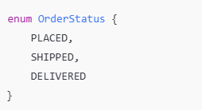




Problem – without enum
Suppose we store order status like this:
Someone may write:
Java Program will not stop this. Program may behave wrongly. This is where ENUMS comes into picture.
This is not allowed now, Java will handle automatically.

Slide 17
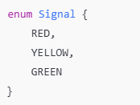
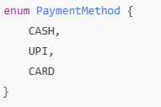


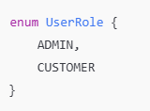


Examples:
Decision making becomes very easy with enums…!

Slide 18
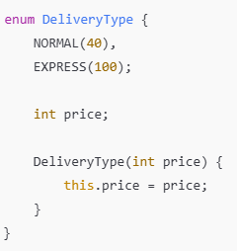

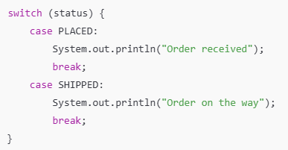
Examples:
Example: In amazon, we have product deliveries with types and prices.
Switch case example with enums

Slide 19
Why Enums?
Advantages of enums:
Improves code readability
Avoids magic numbers and strings
Prevents invalid values
Used in workflows and state machines
Enums are commonly used in:
Order processing systems
Payment status tracking
User roles and permissions

Slide 20
OOPs Applications
OOP concepts are used in almost every modern software system:
Banking Systems – Account, Transaction, Customer
E-commerce Platforms – Product, Cart, Order
Enterprise Applications – ERP, CRM
Game Development – Player, Enemy, Weapon
System Design – Service models, domain entities
OOP is the backbone of scalable and maintainable systems.

Slide 21
OOPs Concept – System Design
Mapping OOP to System Design:
Classes → Domain models and service components
Objects → Runtime instances
Abstraction → APIs and service interfaces
Encapsulation → Module boundaries
Interfaces → Contract-first design
Strong OOP fundamentals lead to better Low-Level Design.

Slide 22
Introduction to advance OOP concepts
Advanced Object-Oriented Programming concepts help in building flexible, reusable, and scalable software systems.
These concepts allow classes and objects to interact with each other in meaningful ways and support real-world modeling.
Inheritance and polymorphism enable code reuse and extensibility, while class relationships define how objects are connected within a system. These concepts are fundamental to Low-Level Design (LLD) and object modeling using UML diagrams.

Slide 23
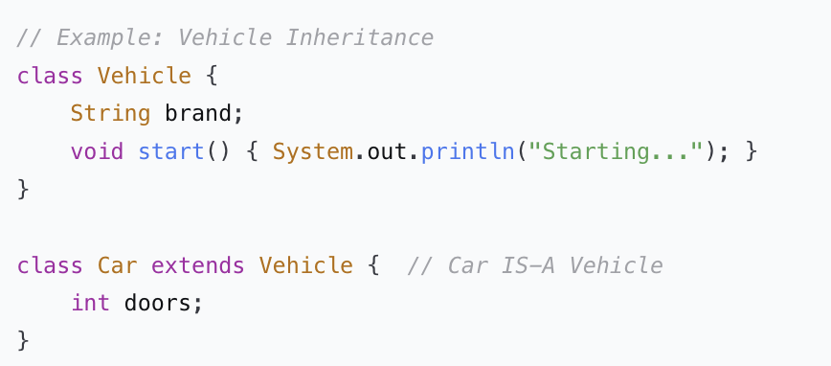
Inheritence
What is Inheritance?
Mechanism where one class acquires properties/behavior of another
IS-A Relationship: Derived class is a specialized version of base class
Promotes Code Reuse and establishes natural hierarchies
Key Terminology:
Base/Parent/Superclass: Class being inherited from
Derived/Child/Subclass: Class that inherits
Single Inheritance: One parent class (Java, C#)
Multiple Inheritance: Multiple parents (C++, Python)

Slide 24
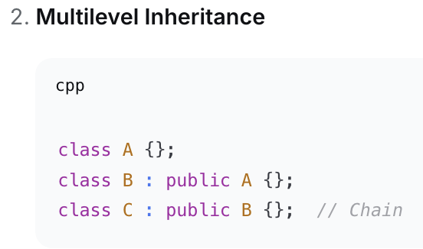
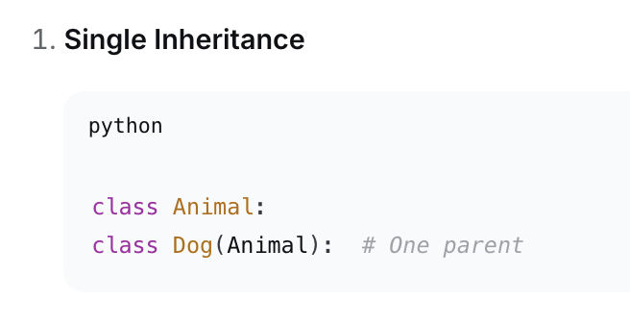
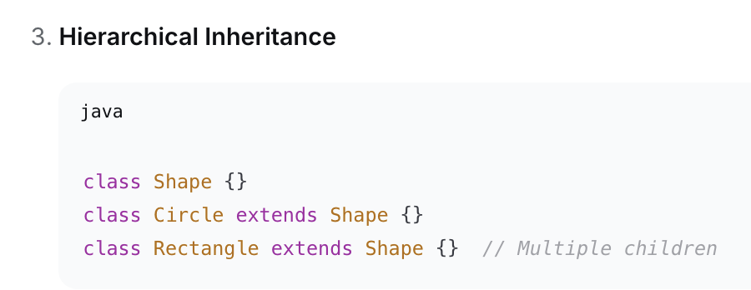
Inheritance - Types
Common types of inheritance include:
Single Inheritance – One parent, one child
Multilevel Inheritance – Chain of inheritance
Hierarchical Inheritance – Multiple children, one parent
Multiple Inheritance – Multiple parents (via interfaces in Java)
Inheritance promotes code reuse and logical hierarchy in software systems.

Slide 25
Inheritance – Advantage vs Limitation
Advantages:
Reduces code duplication
Improves maintainability
Establishes clear hierarchy
Limitations:
Tight coupling between parent and child
Changes in parent class can affect child classes
Overuse can lead to rigid designs
In system design, inheritance should be used carefully and often combined with composition.

Slide 26
Polymorphism
Polymorphism means “many forms.” It allows the same method or interface to behave differently based on the object invoking it.
Polymorphism enables dynamic behavior at runtime and improves system flexibility.
Example:
A method calculateSalary() behaves differently for Employee, Manager, and Intern objects.
There are two main types:
Compile-time Polymorphism
Achieved using method overloading
Runtime Polymorphism
Achieved using method overriding and inheritance
Runtime polymorphism is heavily used in frameworks, APIs, and system design.

Slide 27
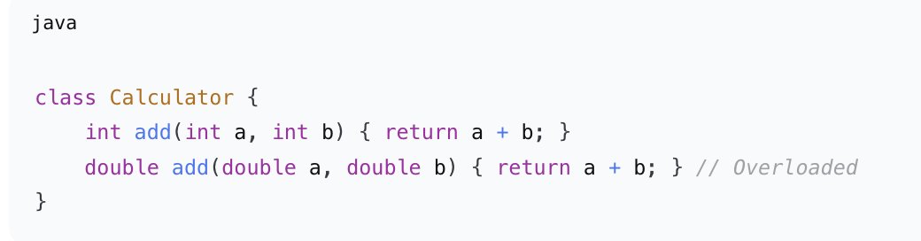
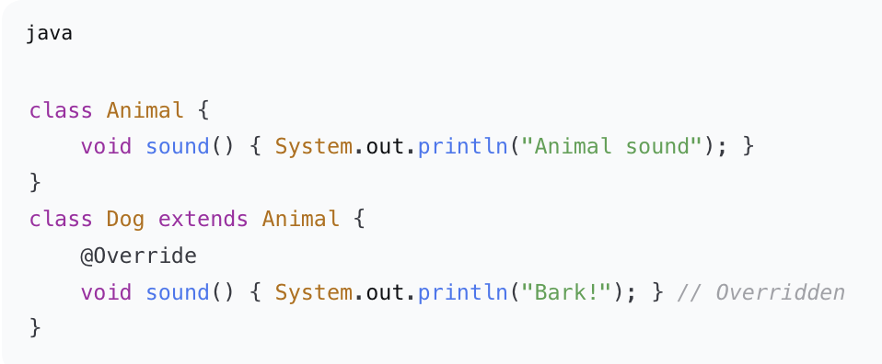
Polymorphism - Types
1. Compile-Time Polymorphism (Static/Early Binding)
Method Overloading: Same method name, different parameters
Operator Overloading (C++, Python)
2. Runtime Polymorphism (Dynamic/Late Binding)
Method Overriding: Subclass provides specific implementation
Requires inheritance + method overriding + upcasting

Slide 28
Polymorphism - Types
Polymorphism provides:
Loose coupling between components
Easy extensibility without modifying existing code
Better abstraction and interface-based design
It follows the Open–Closed Principle:
Open for extension, closed for modification.
Polymorphism is a key concept behind dependency injection and plugin architectures.

Slide 29
Class Relationships
Class relationships describe how classes and objects are connected to each other in a system.
Why Relationships Matter?
Real-world modelling: Objects don't exist in isolation
Software Design: Relationships affect coupling, cohesion, maintainability
UML Representation: Visual design communication
Four Key Relationships:
Association → "Uses"
Aggregation → "Has-a" (Weak ownership)
Composition → "Part-of" (Strong ownership)
Dependency → "Depends-on"

Slide 30
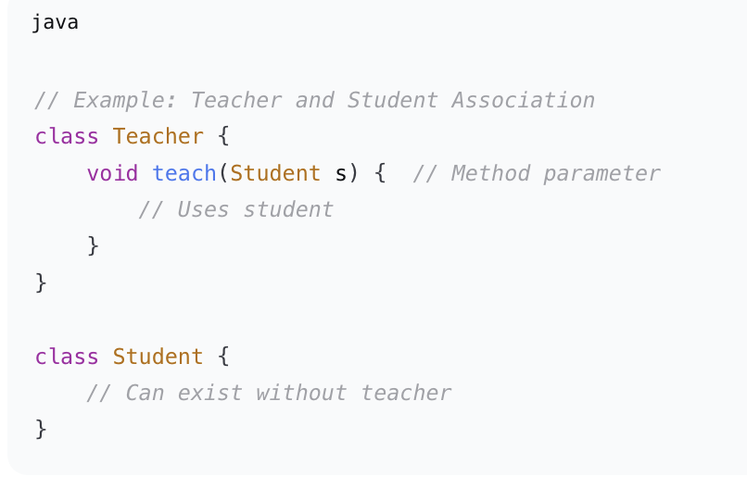
Association
Association represents a relationship where objects of one class are connected to objects of another class.
"A uses B"
Weakest relationship between two independent classes
Both exist independently - lifecycle not tied
Can be: Unidirectional or Bidirectional
It represents a “uses” or “knows” relationship.
Example:
Teacher and Student
Doctor and Patient
Association can be:
One-to-one
One-to-many
Many-to-many

Slide 31
Association
Key points about association:
Objects have independent lifecycles
One object can exist without the other
Weak relationship
Real-world Example:
Doctor ↔ Patient (appointment)
Customer ↔ Product (browsing)
UML: Solid line between classes (optional arrows for direction)
Association is commonly used to represent interactions rather than ownership.

Slide 32
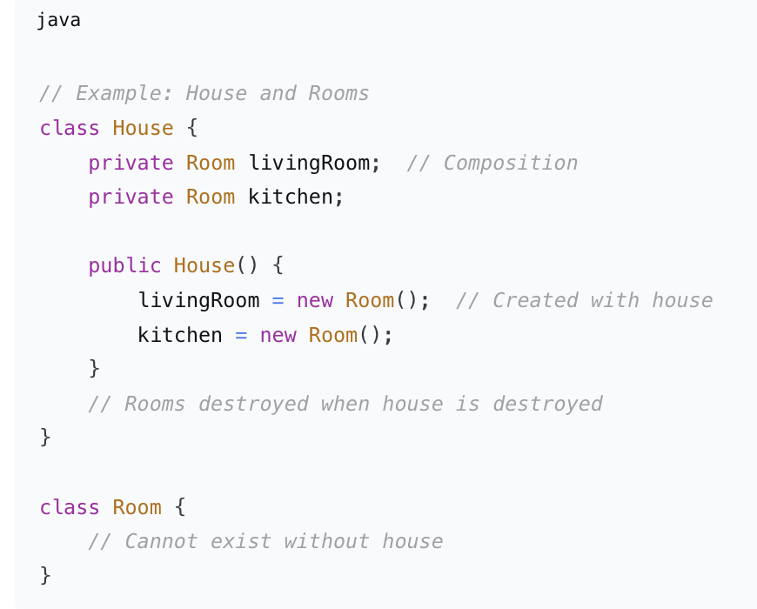
Composition
Composition is a strong form of aggregation that represents a strong “has-a” relationship.
"Part-of" (Strong Ownership)
Strongest relationship - exclusive ownership
Parts cannot exist without whole
Same lifecycle - part created/destroyed with whole
In composition:
The part cannot exist without the whole
Lifecycles are tightly bound
Example:
House and Rooms
Order and OrderItems
If the whole is destroyed, the parts are destroyed as well.

Slide 33
Composition – Why it is preferred?
Composition provides:
Better encapsulation
Clear ownership
Flexible and maintainable design
Modern system design follows the principle:
“Favor composition over inheritance.”
Composition reduces tight coupling and improves scalability.
Real-world Example:
Human ↔ Heart (heart cannot exist independently)
Car ↔ Engine (specific engine belongs to specific car)
UML: Solid line with filled diamond at whole side

Slide 34
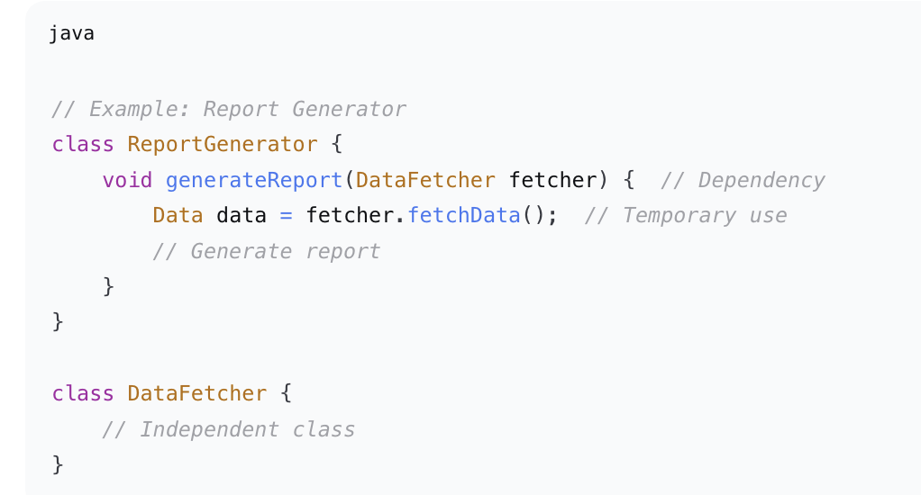
Dependency
Dependency represents a relationship where one class depends on another class temporarily to perform a task.
"Depends-on" (Temporary Use)
Most temporary relationship
One class uses another briefly
Typically through: Method parameters, return types, local variables
It is the weakest relationship.
Example:
A service class using a logger
A method using a database connection
Dependency often appears as method parameters or local variables.

Slide 35
Dependency – Role in System Design
Dependency is important for:
Loose coupling
Testability
Dependency Injection
Reducing dependencies makes systems easier to modify and scale.
Frameworks like Spring heavily rely on dependency management.
When it Occurs:
Method parameter/return type
Local variable in method
Static method call
UML: Dashed line with arrow

Slide 36
Comparison of Class Relationship
Aspect | Association | Aggregation | Composition | Dependency
Relationship | Uses | Has-a (weak) | Part-of | Depends-on
Lifespan | Independent | Independent | Same | Independent
Strength | Weak | Medium | Strong | Very Weak
Ownership | No | Shared | Exclusive | No
UML | Solid line | Empty diamond | Filled diamond | Dashed arrow
Association – Uses/knows relationship
Aggregation – Weak ownership
Composition – Strong ownership
Dependency – Temporary usage
Understanding these relationships helps in designing clean UML diagrams and robust LLD.

Slide 37
Design Considerations
Ask These Questions:
Does B exist without A?
No → Composition
Yes → Association/Aggregation
Is B shared between multiple A's?
Yes → Aggregation
No → Composition
Is the use temporary?
Yes → Dependency
Just using without ownership?
Yes → Association
Design Principle:
"Favor Composition over Inheritance" - Gang of Four
More flexible
Less coupling
Easier to change at runtime

Slide 38
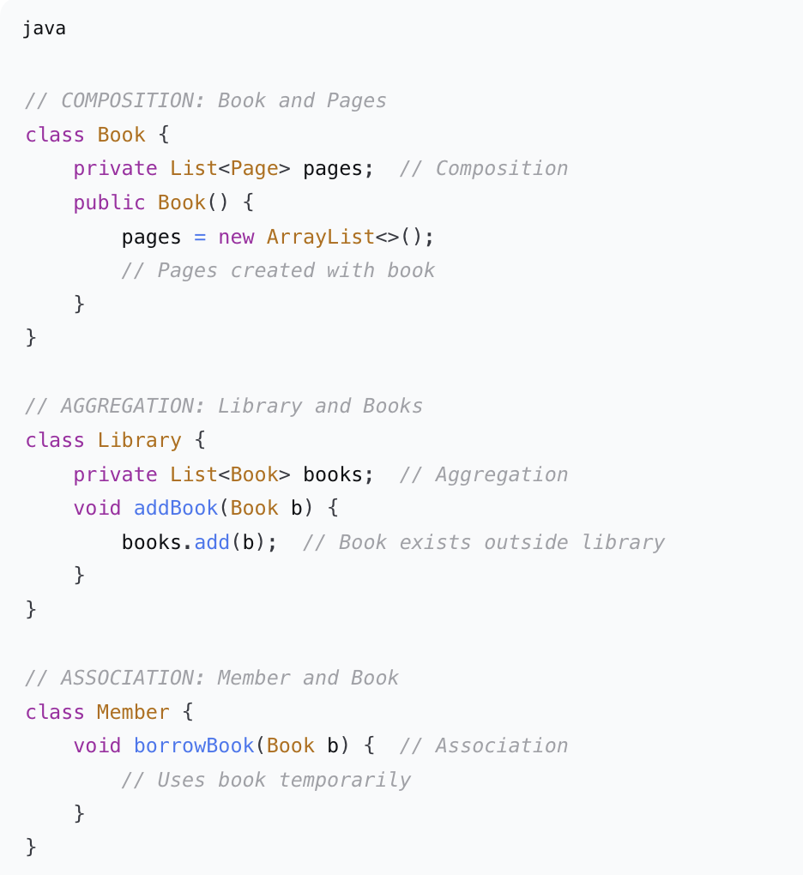
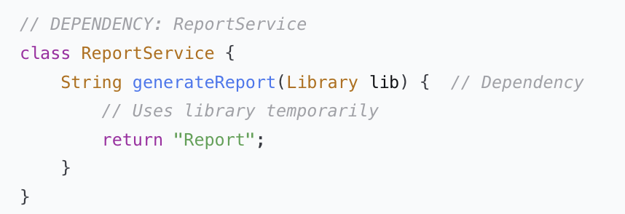
Example – Library System

Slide 39
Common Pitfalls & Best Practices
Pitfalls to Avoid:
Overusing Inheritance → Creates fragile hierarchies
Confusing Aggregation with Composition → Wrong lifecycle assumptions
Circular Dependencies → Creates tightly coupled code
God Classes → Too many associations/responsibilities
Best Practices:
Use inheritance only for true "is-a" relationships
Prefer interfaces for polymorphism (Java/C#)
Apply Law of Demeter: "Talk to friends, not strangers"
Keep relationships minimal → Reduce coupling
Document relationships clearly in design phase

Slide 40
Quick Questions?
What is the difference between a class and an object?
Why is abstraction important in large systems?
How does encapsulation improve security?
Why are interfaces preferred in scalable systems?
Where should enums be used instead of constants?
.

Slide 41
Quick Questions?
Q: Can a class exist without objects? A: Yes, but it will not occupy memory.
Q: Can interfaces contain method implementation? A: Depends on the language (e.g., default methods in Java).
Q: Why is OOP important for system design? A: It enables modular, scalable, and maintainable architecture.

